Slide 1

NETBANKING
Team Member
Satvik Gupta (10800222125)
Ch Sneha (10800223180)
Dhrubayan Banerjee (10800222021)
Ehtesam Khan (10800223181)
Trainer name : Arindam Sengupta

Slide 2
Introduction
Net Banking Overview:
Net banking, also known as online banking, enables customers to access banking services over the internet without visiting a physical branch.
Importance of Net Banking:
Convenient and accessible 24/7.
Reduces reliance on manual processes.
Supports a cashless economy.
Project Objectives:
The objective of this project is to utilize the concepts and technologies to build a secure and fully functional net banking system. This system will include essential features such as payments, deposits, and seamless transactions, ensuring a user-friendly and efficient experience so our project name is FBI(Finance Bank of India).

Slide 3
Features of the System
Completed Features:
Login page
First Page: User-friendly interface.
Profile Management: Displays account details and allows management. Payment Page: Facilitate secure transactions.
Support Page: Dedicated for customer queries and assistance.

Slide 4
Project Implementation
Progress So Far:
Designed and developed the following pages:
Login page: User can login and access the website.
Default Page: User-friendly interface for navigation.
Profile Page: Displays account details and management options.
Payment Page: Facilitates secure online transactions.
Support Page: Dedicated section for customer queries and assistance.
Integrated MySQL database using MySQL Command Shell for secure and efficient data handling.
Development Environment: Project developed using Eclipse IDE for seamless coding and debugging.

Slide 5
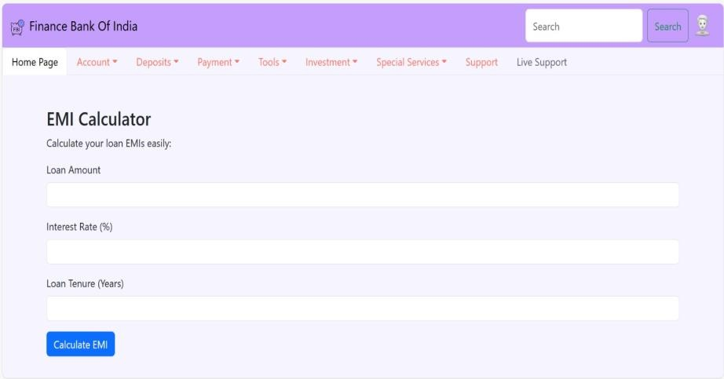
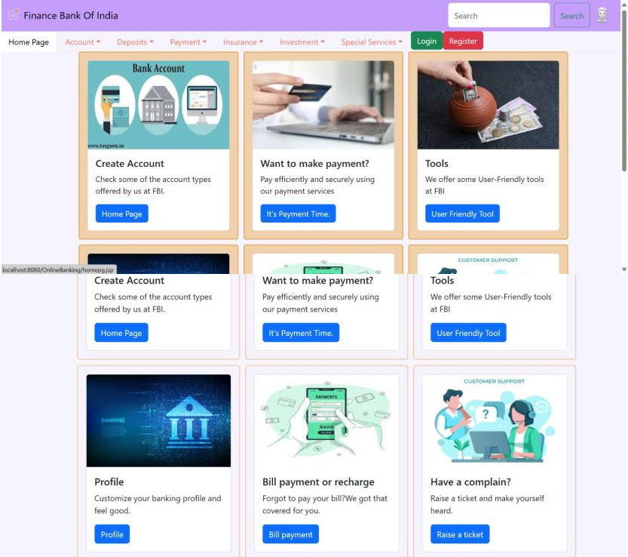
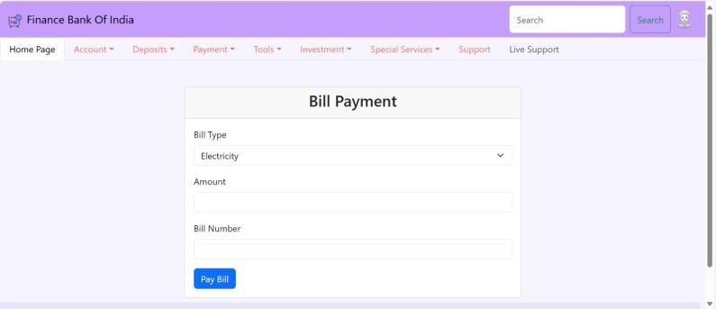
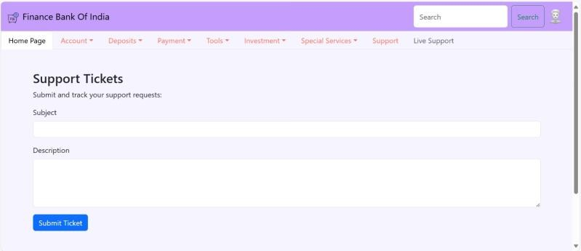
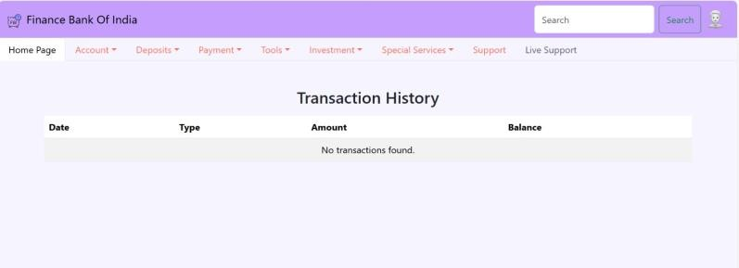
Some project preview

Slide 6
Conclusion
This project focuses on creating a secure and efficient net banking platform using a combination of frontend and backend technologies. The platform includes key features such as Home, Account, Deposits, Payments, Insurance, Investment, Special Services, and Support Pages.
Through the use of JSP for server-side processing and MySQL for managing data, the system aims to ensure seamless transactions and a user-friendly experience. The frontend, designed with HTML, CSS, and JavaScript, provides an intuitive interface for easy navigation.
The integration of database and backend functionalities is progressing well, and the project has laid a strong foundation for delivering a robust net banking solution that caters to user needs efficiently.

